Slide 1
RAJIV GANDHI UNIVERSITY OF KNOWLEDGE AND TECHNOLOGIES Department of Computer Science and Engineering(C.S.E)
Signature Forgery Detection using Transfer learning
Presented By:
V. Naveen
G. Akhil
M. Pavan
M. Deepika
D. Priyanka
Guided By:
Mrs. Blessy
Computer Science and Engineering

Slide 2
Abstract
Handwritten signatures are very important in our social and legal life for verification and authentication. The probability of two signatures made by the same person being the same is very less. Many properties of the signature may vary even when two signatures are made by the same person. So, detecting a forgery becomes a challenging task.
In this paper, a solution is based on Deep Convolutional Neural Network [CNN] is presented . We use the concept of transfer learning i.e fine-tuning of VGG16 model means we use the pretrained model (VGG16) as a feature extractor.

Slide 3
contents
Introduction
Challenges
Thesis Objective
VGG 16 model
Proposed method
Data collection
Implementation
Sample code
References

Slide 4
Introduction
The signature is a legal mark or scripted name of an individual on an instrument or document to signify the approval, acceptance or obligation
Signature forgery refers to the act of falsely replicating the signature of another person.
Cheque fraud
Illegal registrations
To handle this type of situations, we made a project named as “Forged Signature Detection” to detect the signatures which are genuine or forged. We scan the image of signature file and give into the model and it can predict the signature is valid or not.

Slide 5
Challenges
Enlargement of characters
Tendency of curves to become angles
Retouching
Punctuation
Differing pressure
Sudden Endings
Baseline Error
Spacing
Bad line quality

Slide 6
Thesis Objective
Our main objective of this thesis is to develop a model that will find the forged Signature.
There a lot of signature forgery detection models . our goal is to improve the accuracy of the model.so that it can easily detect the forged signatures,
Is Forged /Genuine?
Input signature
Our model

Slide 7
VGG 16(Feature extractor)
It is one of the pretrained models. There are many pretrained models for image classification which are trained on imagenet dataset which contains more than 14 million images. Some of the models are given below which are found in keras library.
VGG 16 layers
1) Conv3D 10) Conv3D+MaxPooling
2) Conv3D+MaxPooling3D 11) Conv3D
3) Conv3D 12) Conv3D
4) Conv3D+MaxPooling3D 13) Conv3D+MaxPooling
5) Conv3D 14) Dense
6) Conv3D 15) Dense
7) Conv3D+MaxPooling3D 16) Dense
8) Conv3D
9) Conv3D

Slide 8
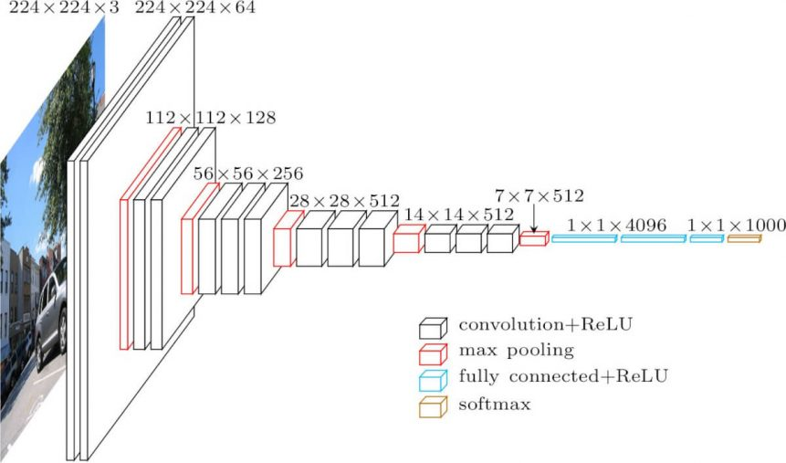
VGG16 pretrained model visualization

Slide 9
Convolution layer
A convolution is a linear operation that involves the multiplication of input matrix with kernel matrix, with the stride and kernel shape.
Which is used to extract the features of the image by applying different types of filters.

Slide 10
Max pooling
objective is to down-sample an input representation (image, hidden-layer output matrix, etc.), reducing its dimensionality and allowing for assumptions to be made about features contained in the sub-regions Binned.

Slide 11
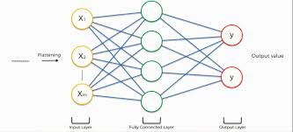
Fully Connected network
In VGG 16,last three layers are collectively called as fully connected network
It contains three dense layers but in our proposed model we have dense + dropout ,dense+ dropout , output layer(sigmoid).

Slide 12
Proposed system
The proposed system is based on pretrained model named as VGG16 and it is used as a feature extractor and the fully connected layers was designed for our specification (we have 2 classes to predict).
VGG 16
(13 layers)
Feature extraction
FC(3 layers)
Feature classification
Input Image
Is forged /genuine?

Slide 13
Data collection
The signatures were taken from various sources and create a dataset named as "my dataset” and in that dataset we were classified the images as shown in the below table:-
Dataset contain 7855 signature image files.
Dataset | Forged signatures | Genuine signatures | Total
Train | 3666 | 2596 | 6262
Test | 384 | 1182 | 1566
Validation | 13 | 14 | 27
Total signatures | 4063 | 3792 | 7855
We split the data (signature dataset) into 70:30 ratio.

Slide 14
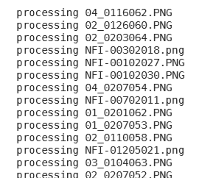
Implementation
1.Image preprocessing
Resizing of images is a crucial step of this project. Because the images have different range of sizes which is not required by the VGG16 model. The VGG16 model has a default input shape is [224,224].so we need to resize all of the images in the dataset with the python code.

Slide 15

2.Import VGG 16 model For feature extraction we have to import the VGG 16 model from keras library VGG 16 model trained on imagenet dataset.
3.Feature extraction
Extract the features of the image by using VGG 16 model.

Slide 16
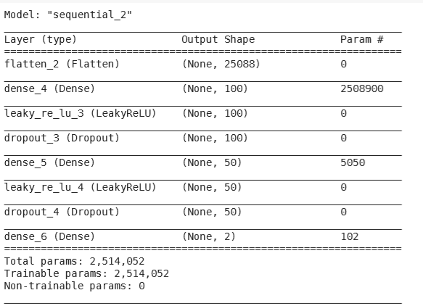
4.Fully connected network This network is used for feature classification(output prediction)

Slide 17
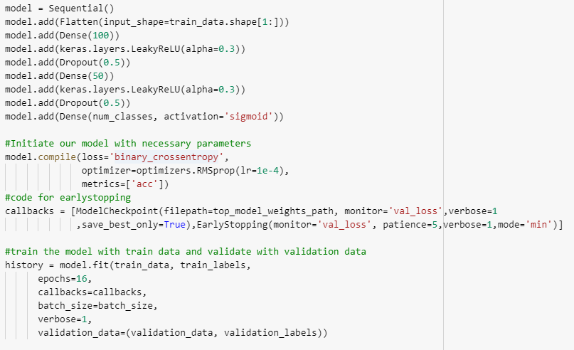
Sample code

Slide 18
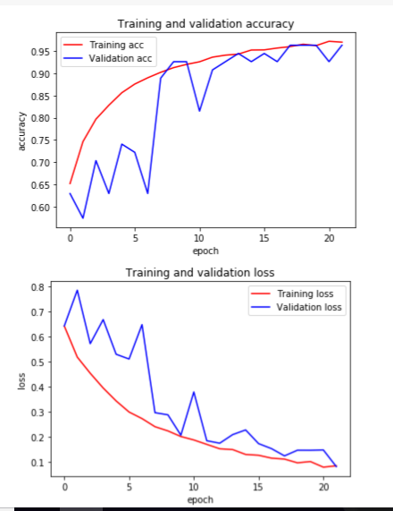
Accuracy Visualization

Slide 19
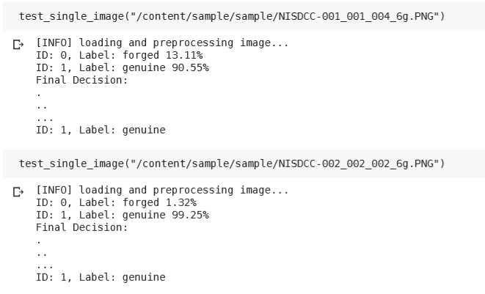
Output prediction

Slide 20
References
. https://arxiv.org/pdf/1409.1556.pdf
2. https://keras.io/
3. https://matplotlib.org/
4. https://machinelearningmastery.com/use-pre-trained-vgg-model-classify-objects-ph otographs/

Slide 21


